Slide 1





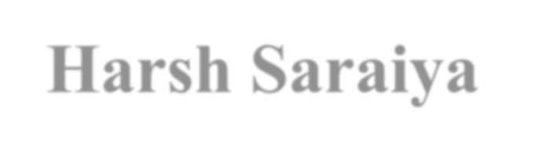

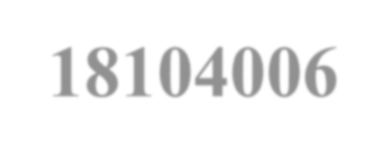
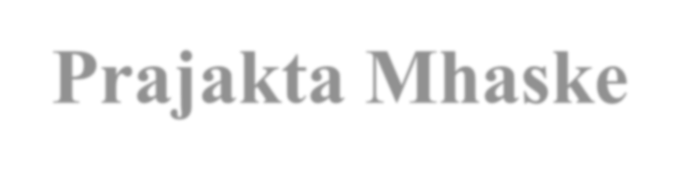
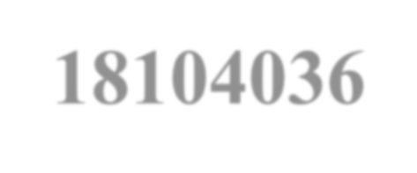


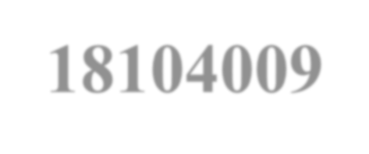
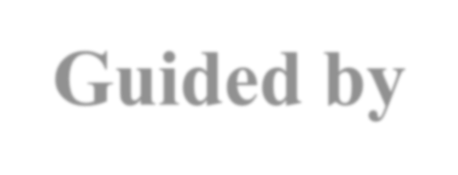
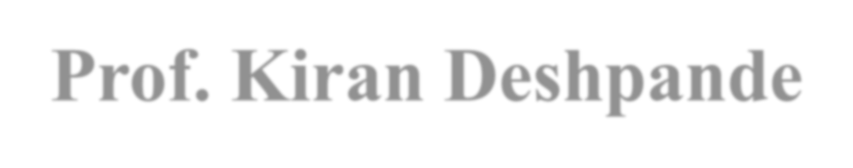
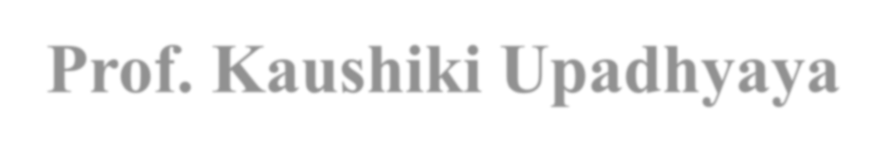
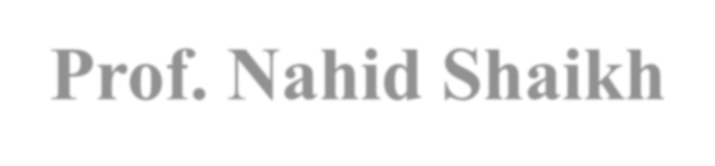
Using ML for Facial Mask Detection
Group No.: 6
Harsh Saraiya – 18104006 Prajakta Mhaske – 18104036 Saloni Rane -18104009
Guided by
Prof. Kiran Deshpande Prof. Kaushiki Upadhyaya Prof. Nahid Shaikh

Slide 2
Contents
Introduction
Litrature Review
Objectives
Scope
Technology Stack
Block Diagram to propose project idea.
Demonstration (Desired)
References

Slide 3

1. Introduction
Problem Identified :
In this phase of covid-19 people are not following proper rules as a precautionary measure.
Though wearing masks is a compulsory action, It is not followed by people.
Solution Proposed :
To design a system which works to detect masked faces and unmasked faces in Covid-19 situation.
It will be a user-friendly system where a webcam or CCTV surveillance will record all the time and check to give an alert message.

Slide 4
2. Literature Review
Sr. No. | Authors | Paper Tittle | Methodologies | Findings
1. | MM Rahman | An Automated System to Limit COVID-19 Using Facial Mask Detection in Smart City Network | Deep Learning Architecture, Image Pre-Processing | An automated smart framework for screening persons who are not using a face mask
2. | Mamata S. Kalas | Real time face detection and tracking using OpenCV | Harr like classifier and AdaBoost algorithm to track faces on OpenCV Platform. | Face detection is a two- class problem where we have to decide if there is a face or not in a picture. This approach can be seen as a simplified face recognition problem.

Slide 5

3. Objectives
To automate the process of face mask detection using a CCTV camera.
To Classify people into masked and unmasked category.
Image recognition of unmasked people and notification alert to the Authority about it.
To help stop the spread of airborne particles (corona virus) from the infected person’s sneezing or coughing by the use of our system.
To ensure a safe working environment by creating an atmosphere of
awareness & preparedness in the locality.

Slide 6
4. Review Suggestions (Given in the last meeting)
To alter the Objectives of our Project.
To build a Mobile Application instead of Web Application and give an alert.
To deploy data on Cloud.

Slide 7

5. Scope
It can be deployed in the college campus area, for students, teachers and other college staff.
Can be used in housing complex, hospitals, and offices.

Slide 8

6. Technology Stack
- Python3, Jupiter Notebook, Google collab
- OpenCV, Tensorflow, Keras
- Firebase

Slide 9
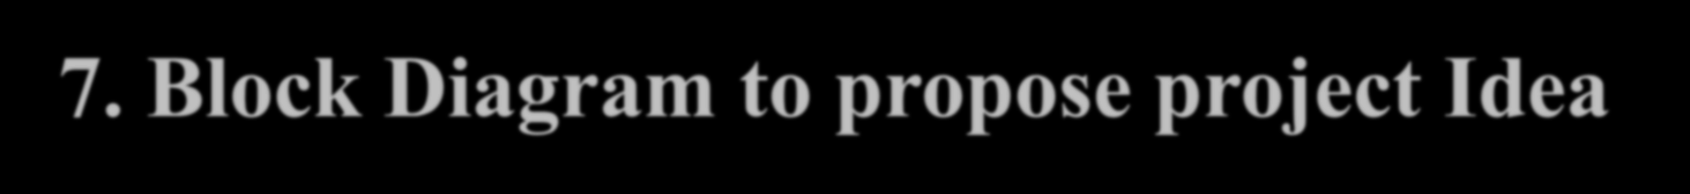
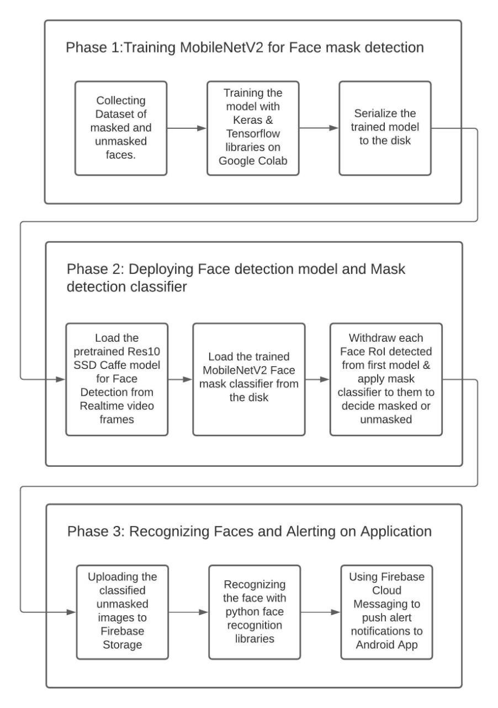
7. Block Diagram to propose project Idea

Slide 10
8. Status of Paper Draft & Targeted Conference
◆ Paper work and Review has been completed
Targeted Conferences:
◆ ICCIC 2021: International Conference
on Cognitive &
&
Intelligent Computing CMR College of Engineering
Technology Hyderabad, India, December 11-12, 2021 Abstract registration deadline : November 15, 2021 Submission deadline : November 20, 2021
◆ ICDE 2022 : International Conference on Data Engineering
Workshops
Paper Submission Deadline : Wednesday 17 Nov 2021

Slide 11


9. References
https://www.researchgate.net/publication/344563082_An_Automated_System_to_Limit
_COVID19_Using_Facial_Mask_Detection_in_Smart_City_Network
( MM Rahman · 2020 · Limit COVID-19 Using Facial Mask Detection in Smart City Network. Date Added to IEEE Xplore: 08 October 2020)
https://www.pyimagesearch.com/2020/05/04/covid-19-face-mask- detector-with-opencv-
keras-tensorflow-and-deep-learning/
(COVID-19: Face Mask Detector with OpenCV, Keras/TensorFlow, and Deep Learning by Adrian Rosebrock on May 4, 2020)
https://www.researchgate.net/publication/345316359_Deep_Learning_Framework_to_Det
ect_Face_Masks_from_Video_Footage
(Deep Learning Framework to Detect Face Masks from Video Footage on November 2020)
.
ReplyForward

Slide 12
Thank You...!!

